Slide 1
SAP HANA Revision Strategy

Slide 2
SAP HANA is very dynamic product. Continuous technology enhancements are delivered once a year (starting with SPS 02) for agile IT.
You can upgrade from any revision to any newer revision, making maintenance very straightforward.
Updates are strictly backward compatible. Incompatible changes may be considered due to legal or security reasons but follow a strict exception approval process.
Bug fixes and performance improvements come regularly
Every bug every found is included into continuous regression testing

Slide 3
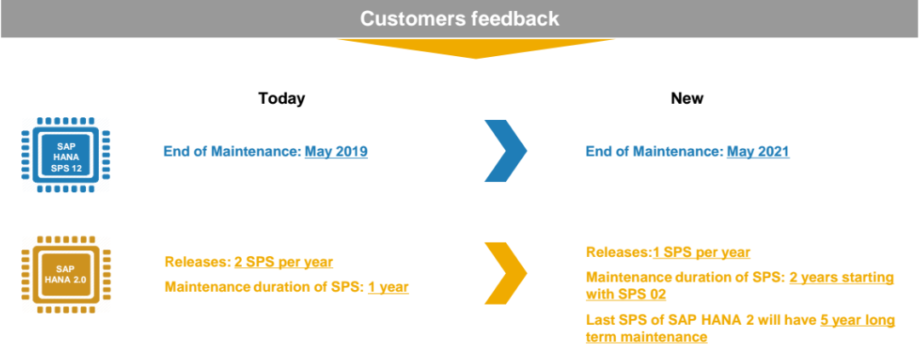
SAP HANA Release Strategy – Key Takeaways
In the context of the SAP HANA platform, corrections are shipped in the form of Revisions and Support Packages of the product’s components.
The term “Revision” refers to packages containing fixes for the SAP HANA core components (SAP HANA Database, Studio, Clients, AFLs, SDA)

Slide 4
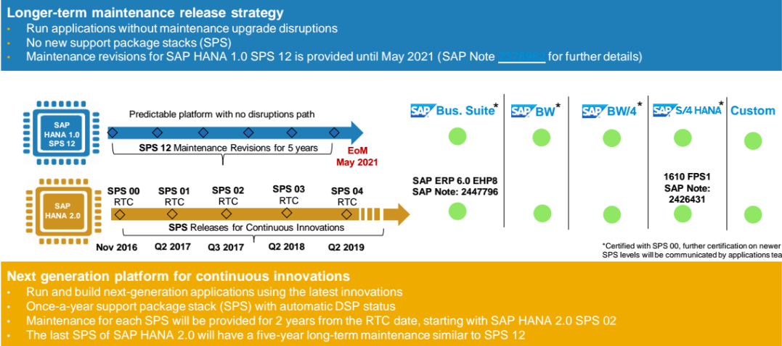
SAP HANA Release Strategy Transition to SAP HANA 2.0

Slide 5
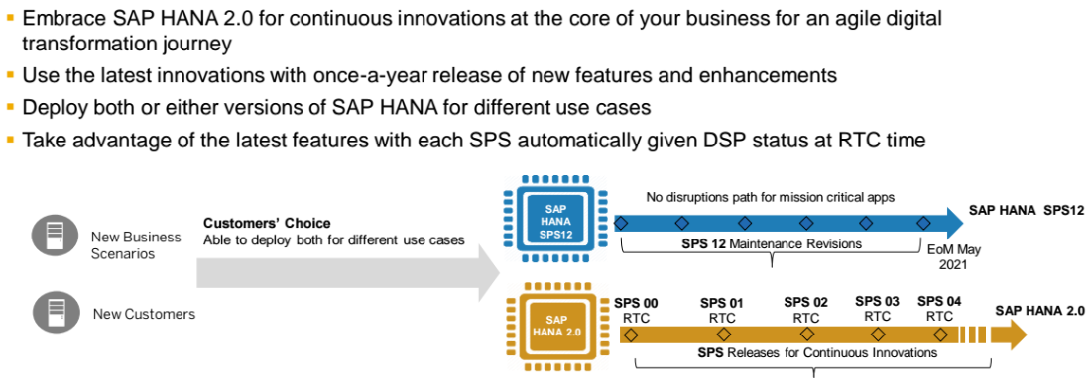
Transition Path to SAP HANA New Customers

Slide 6
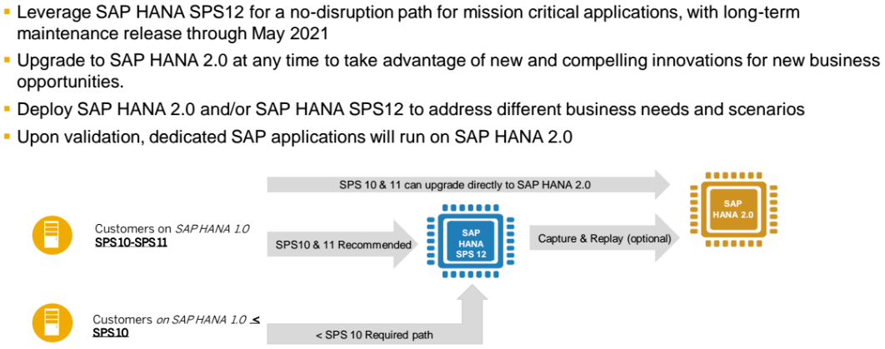
Transition Path To SAP HANA 2.0 Existing Customers

